Slide 1
Malnutrition and Education in China
By: Austin Jia

Slide 2
Motivation
Nutrition and educational attainment are closely linked
Consumption and nutritional content can decide whether a child
Feels the need to leave the household (a safe haven where they can provide for themselves and their family) to pursue learning
Has the energy to focus, learn effectively, and ascend through the educational system
Recall our education unit
Conditional Cash Transfers proved quite successful in India
What about school-provided meals as an incentive?

Slide 3
Research Questions
What is the direction and magnitude of the impact of malnutrition on school enrollment, attainment, and completion in China?
Would school-provided meals be a powerful educational incentive in the developing world?

Slide 4
The Data

Slide 5
Overview
China Health and Nutrition Survey
UNC Population Center
Chinese Center for Disease Control and Prevention
Sampling Frame
12 provinces
8,600 households
35,000 individuals (unit of observation)
Panel Data
9 waves, 1 wave every 4 years from 1989 to 2011
Merged data by unique ID to ensure each individual shows up every wave

Slide 6
Variables of Interest
Response Variables
Explanatory Variables
Enrollment:
Binary
0 = not enrolled, 1 = enrolled
Attainment:
Numeric
Measured in Highest Grade Level Attained
Completion:
Numeric
Measured in Years of Schooling Completed
Different from attainment because a student may have repeated years
Consumption:
Numeric
Grams consumed in three-day period
Individual:
Numeric (Individual ID)
Wave:
Numeric (Year the survey was conducted)
9 waves from 1989 to 2011
Province:
Categorical
12 Provinces sorted by their code

Slide 7
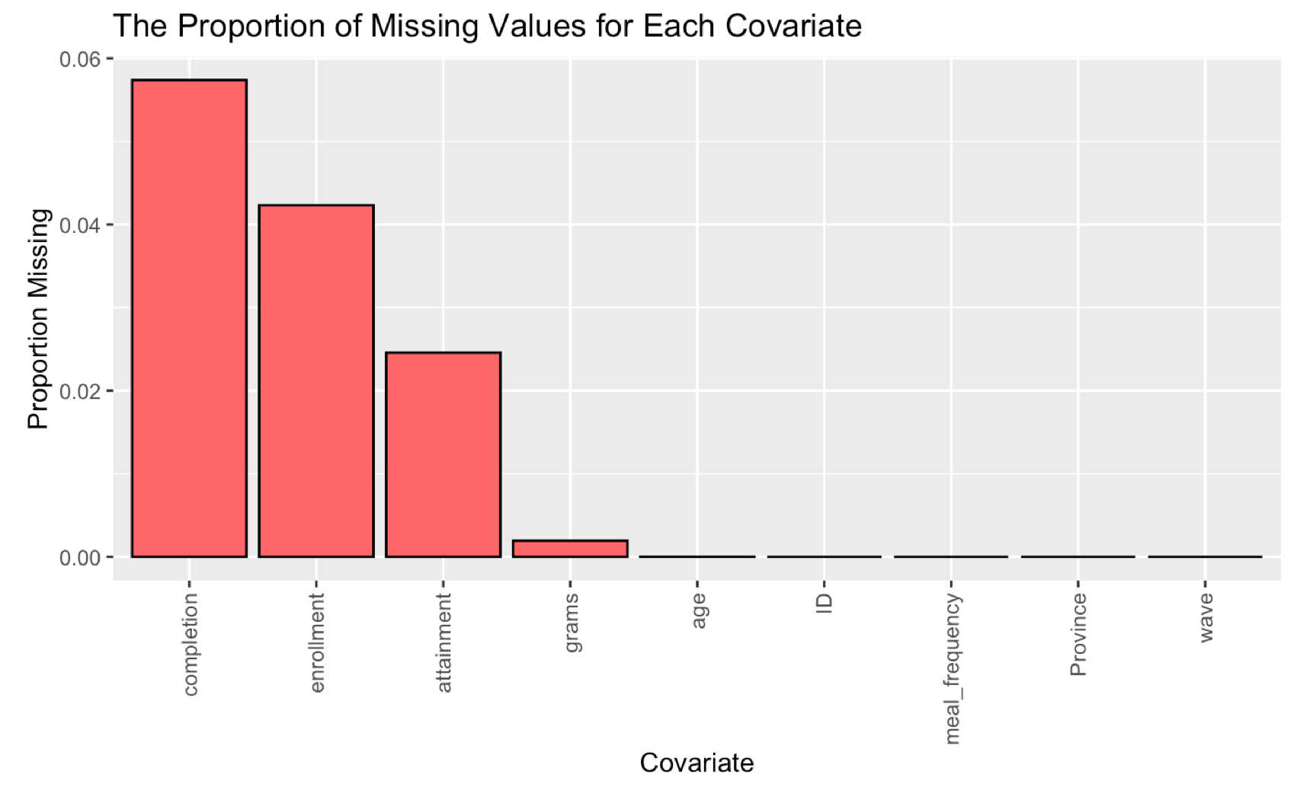
Handling Missing Data
1.4% missing data
90.17% complete case rate
Particularly problematic for our three response variables (completion, enrollment, and attainment)
Use Multiple Imputation Chained Equations (MICE) to impute data

Slide 8
Exploratory Data Analysis

Slide 9
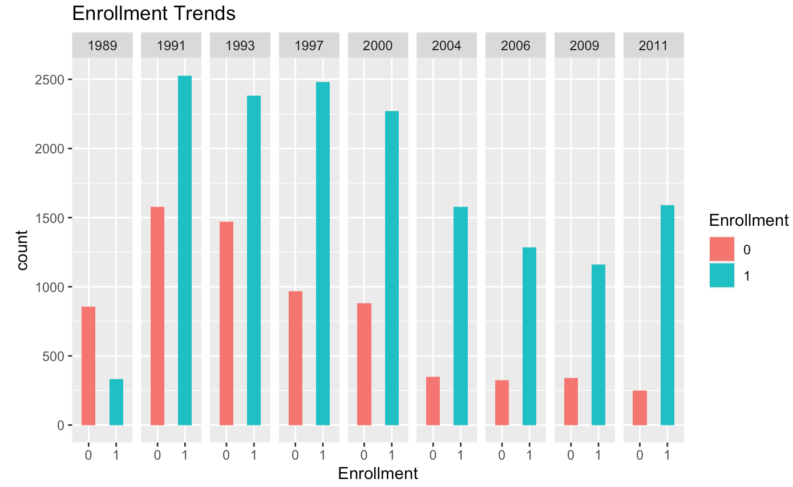
Enrollment
Enrolled students dominate unenrolled students
Disparity widens from 1989 to 2011

Slide 10
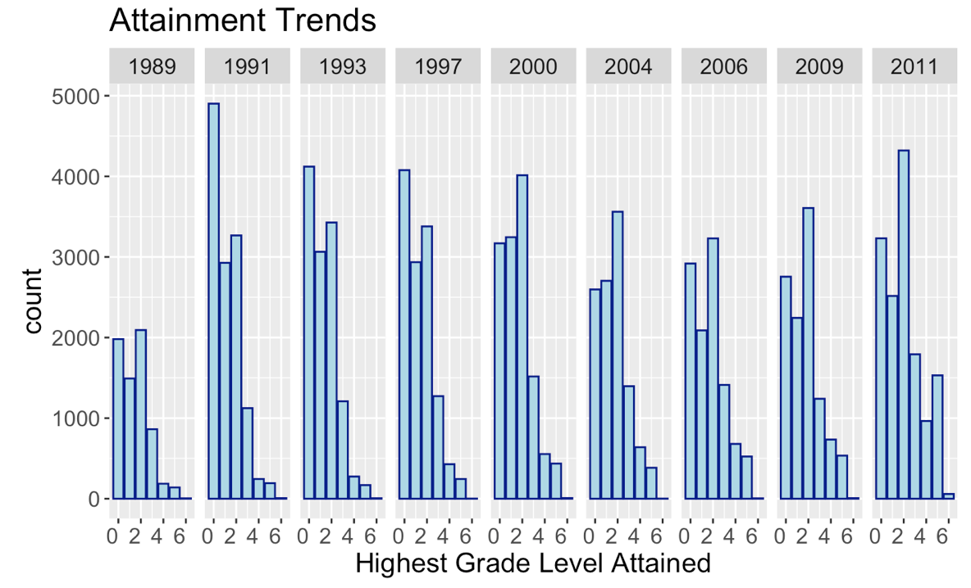
Attainment
Averages concentrated at the primary school level, with a long right tail
Average attainment is increasing
Grade 1.44 in 1989
Grade 1.97 in 2011

Slide 11
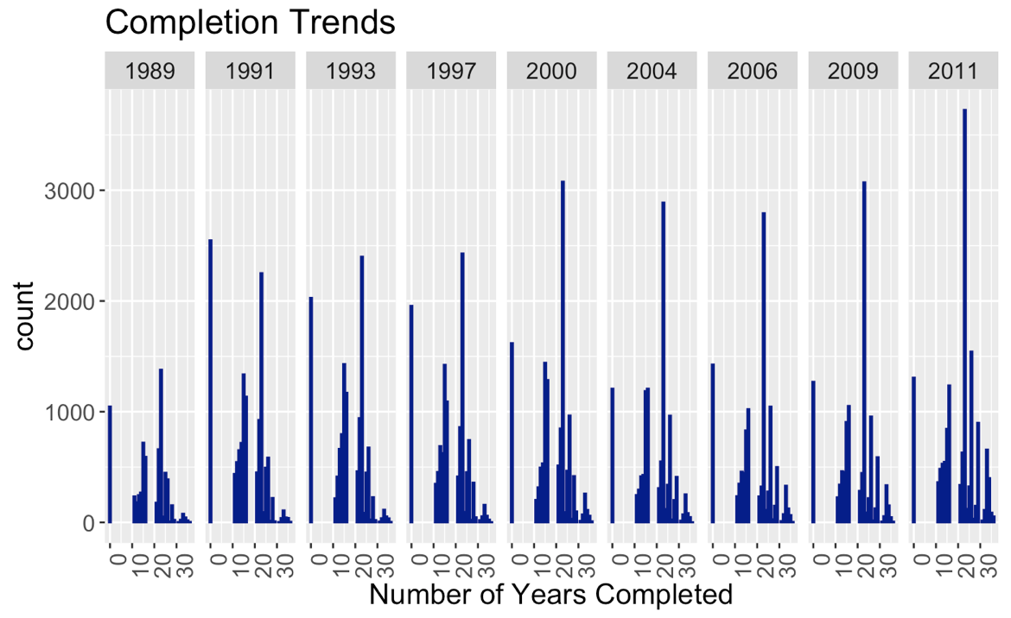
Completion
Roughly normal distribution with long left tails
Average completion is increasing
17.1 years in 1989
20.1 years in 2011

Slide 12
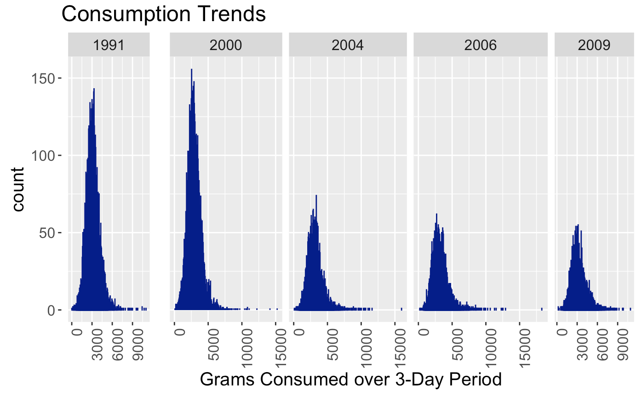
Consumption
Roughly normal distribution
Right-tailed nature of distributions as well as outliers in some years justify log transformation on consumption
Average consumption is increasing
3264 grams in 1989
3317 grams in 2011

Slide 13
Modeling

Slide 14
Model Specification
Response variable: probability of enrollment, highest grade attained, years of school completed
Individual Fixed Effect to capture unobservable personal variability
Province Fixed Effect to capture variability between provinces (Beijing vs. Gansu)
Time-variant explanatory variable of consumption (logged, over a 3-day period)
Survey Year Fixed Effect to capture time-series nature of data
Note: I added age as a time-varying control variable in the enrollment model
Notes:
You’ll notice how it is a very sparse model

Slide 15
Model Justification
Did not include many other controls because
Wanted to really drill down on impact of consumption and create a parsimonious model that allows for simpler interpretation
Fixed Effects models are able to eliminate biases from any omitted time-constant variables (gender)
Use fixed effects in the linear framework even for enrollment, which is a binary response because there were too many levels for logistic fixed effects to handle

Slide 16
Results

Slide 17
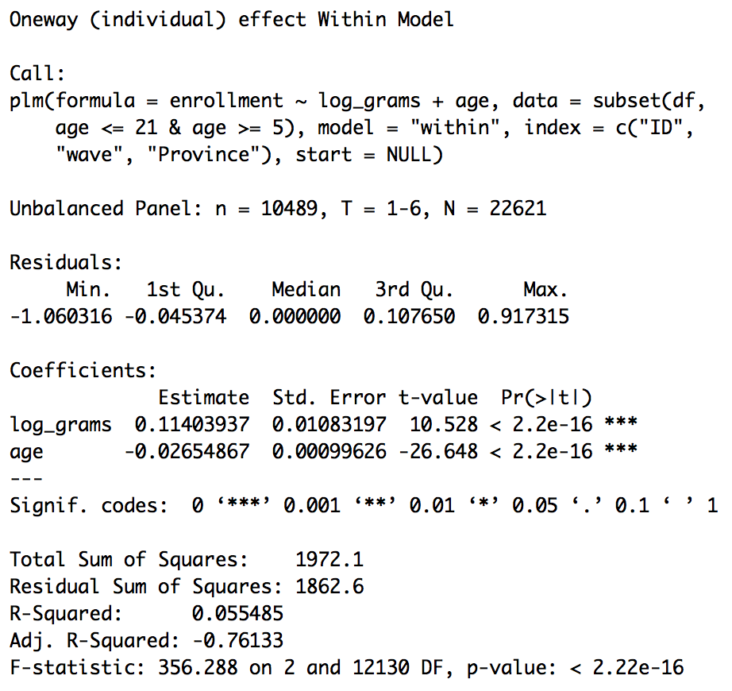
Enrollment
All else constant, a 50% increase in consumption (grams) is associated with a 4.6% increase in probability of enrolling in school
All else constant, a 1 year increase in age is associated with a 2.6% decrease in probability of enrolling in school

Slide 18
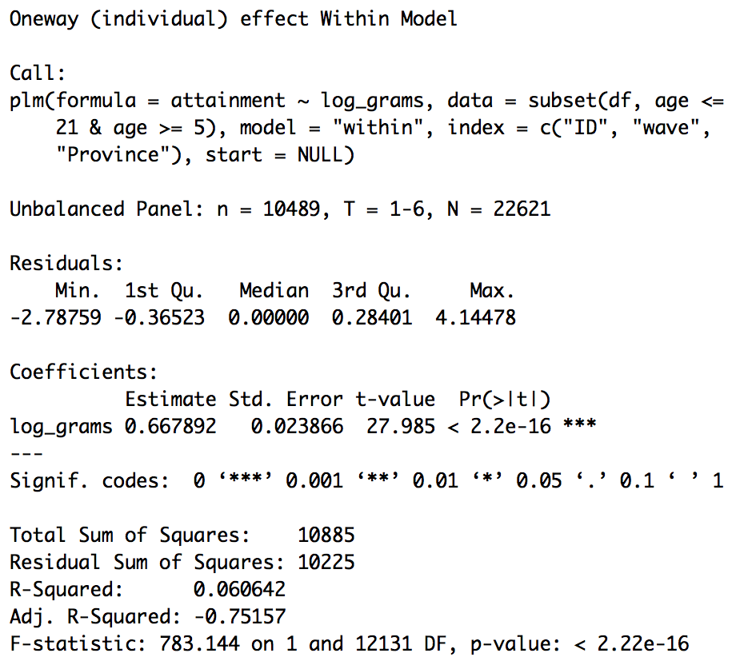
Attainment
All else constant, a 50% increase in consumption (grams) is associated with 0.27 higher mean grade attainment

Slide 19
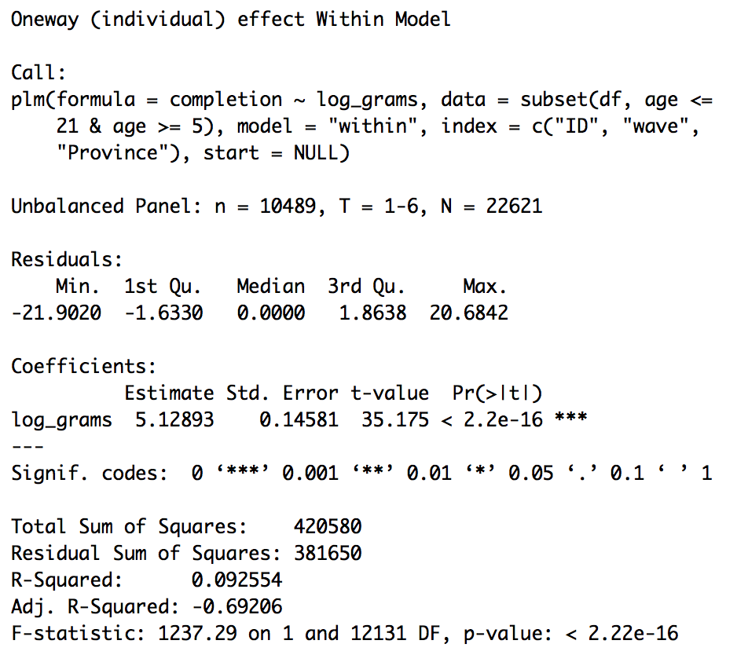
Completion
All else constant, a 50% increase in consumption (grams) is associated with 2.08 more years of school completion on average.

Slide 20
Temporary Takeaways
Relationship | Direction | Magnitude
Consumption on Enrollment | Positive | Moderate
Consumption on Attainment | Positive | Moderate
Consumption on Completion | Positive | Large
Putting the story together
A well-fed child has the energy to:
Make the decision to leave their household and enroll in school
Remain committed to learning in the long-term and both achieve a higher attainment profile and complete more years of schooling
The case for school-provided meals?
Seems strong to me.

Slide 21
Limitations and Next steps
Using a Fixed Effects model with a linear link on enrollment (binary response) weakens predictive power for students at the tails (extremely unlikely or likely to enroll)
Adding in more controls
Wealth
Initially did not include control for income level because the data is oversampled on low-income households
Using better proxies for nutrition
Data about protein/energy content

Slide 22
References
Literature Review
Glewwe, Paul, and Edward A. Miguel. “Chapter 56 The Impact of Child Health and Nutrition on Education in Less Developed Countries.” Handbook of Development Economics, 2007, pp. 3561–3606., doi:10.1016/s1573-4471(07)04056-9.
Data Sourcing
“China Health and Nutrition Survey.” China Health and Nutrition Survey - China Health and Nutrition Survey (CHNS), www.cpc.unc.edu/projects/china.

